Slide 1

Superman Application
Brief Overview of the Modules for FLM and SLM

Slide 2
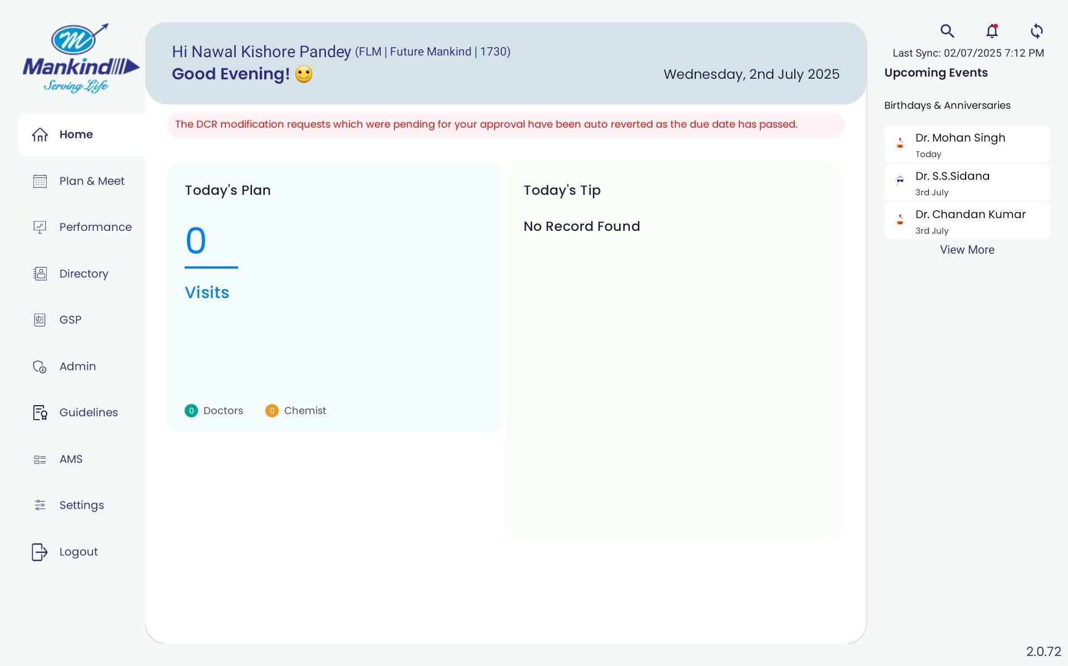
HOME SCREEN shows the planned customer and chemist calls as per the Tour plan
Upcoming events, notifications, and sync status can be checked on the home page as well
Since the manager only adds MR in JFW in TP, so it can show 0 planned visits even though TP is planned.
FLM- 10011118
PWD - RAMGARH@1234

Slide 3
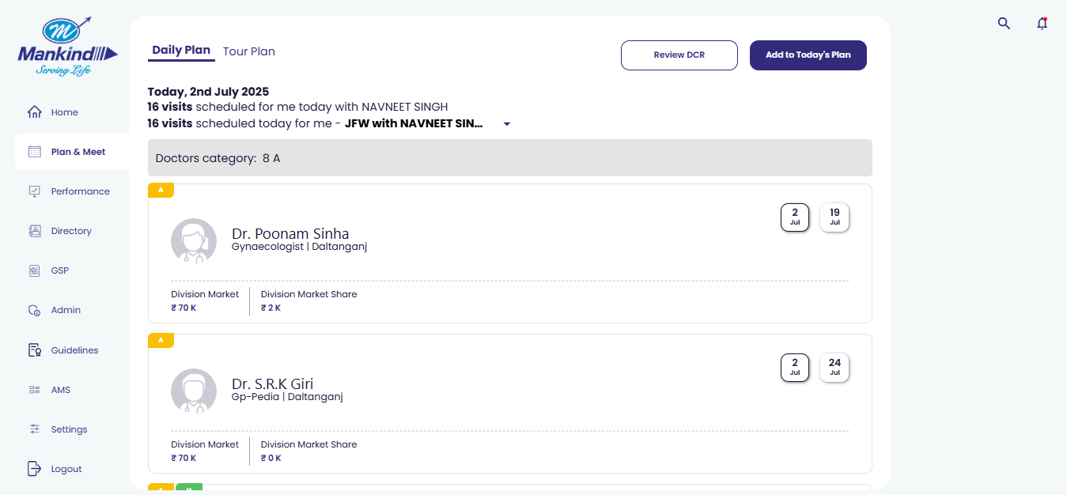
On the PLAN & MEET you will find options for daily plan and tour plan
The daily plan will show the planned customers and chemist calls for the selected MR
To plan DCR, you can click REVIEW DCR
To add calls in today’s DCR, click on the Add to today’s plan option

Slide 4
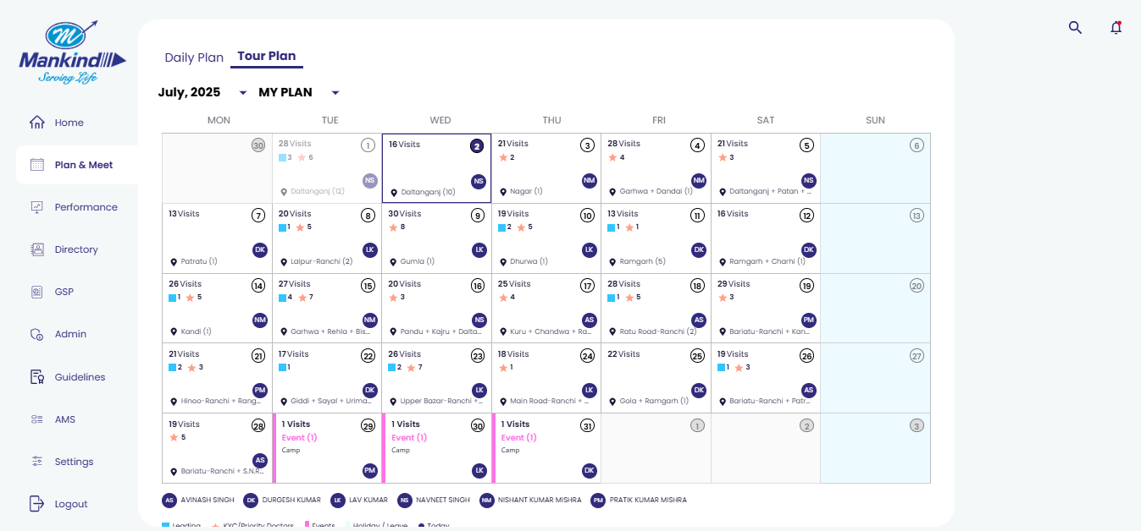
Tour plan shows the detailed planning for the month.
The manager’s tour plan for the next month is submitted from the 23nd to the end of the current month.

Slide 5
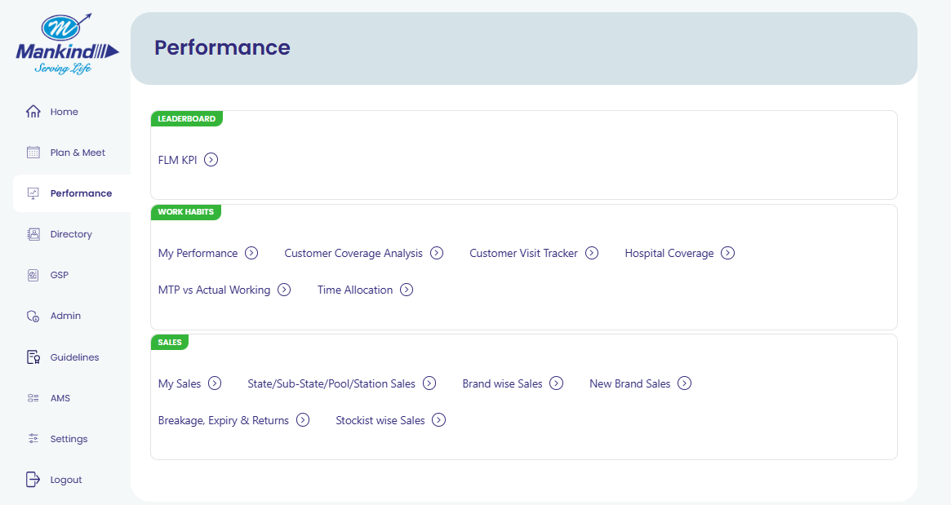
Performance Dashboard is for detailed reports of KPI, Customer & chemist coverage, and the sales report for the managers
Performance Dashboard for FLM
FLM’s KPI is in the performance dashboard
To check Customer and chemist coverage of MR, leading customer coverage, TP deviation, and hospital coverage reports
Detailed sales dashboard according to geographies and Brands

Slide 6
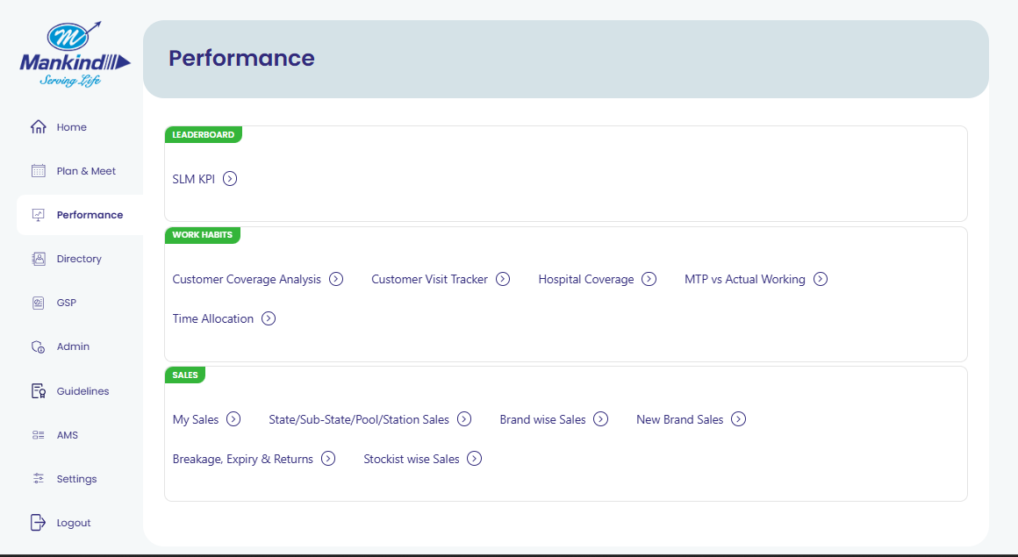
Performance Dashboard for SLM
SLM’s KPI is in the performance dashboard
My performance is not available for SLM, but they can check the leading customer coverage, JFW & TP deviation, and hospital coverage reports
Detailed sales dashboard according to geographies and Brands

Slide 7
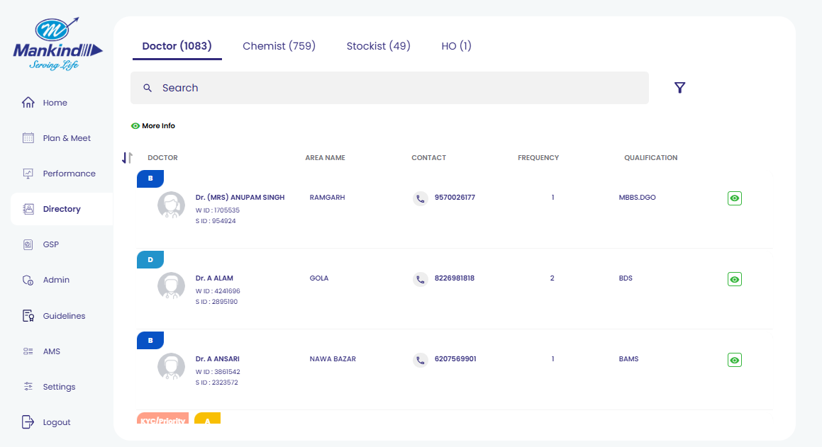
The directory provides a summed-up list for customers, chemists, and stockists according to the MRs in the team

Slide 8
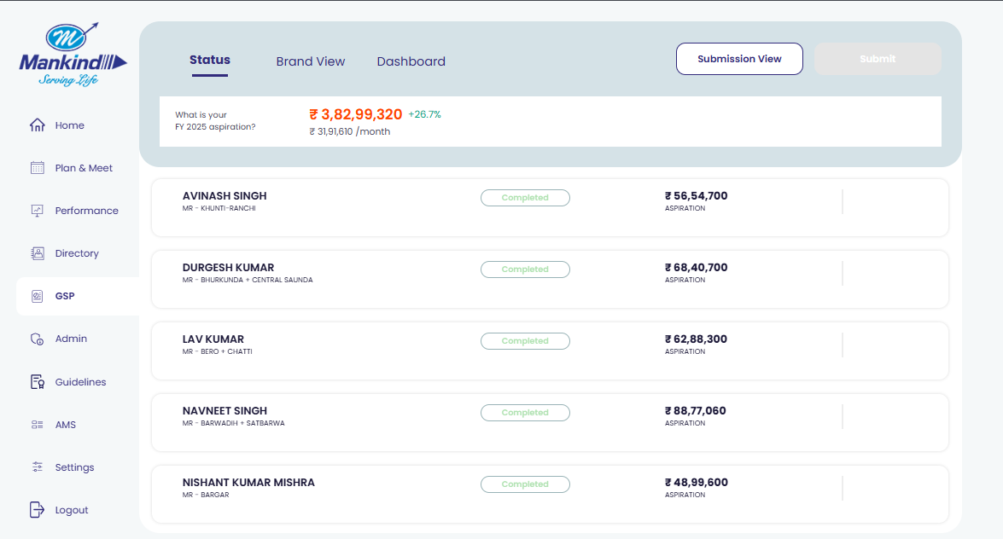
GSP module is for the Granular sales planning for the submitted for the upcoming financial year. It’s a once-in-a-year planning submitted at the start of every financial year
All the MRs in the team submit the GSP, which is then reviewed, approved, or rejected by the manager.
For the MR who is not available or vacant area, GSP is planned and submitted by the manager

Slide 9
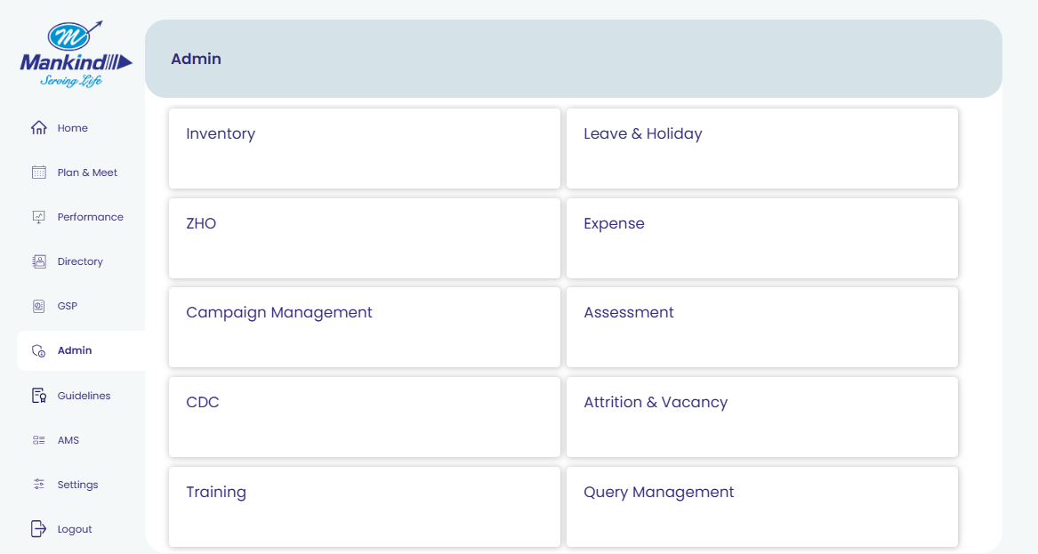
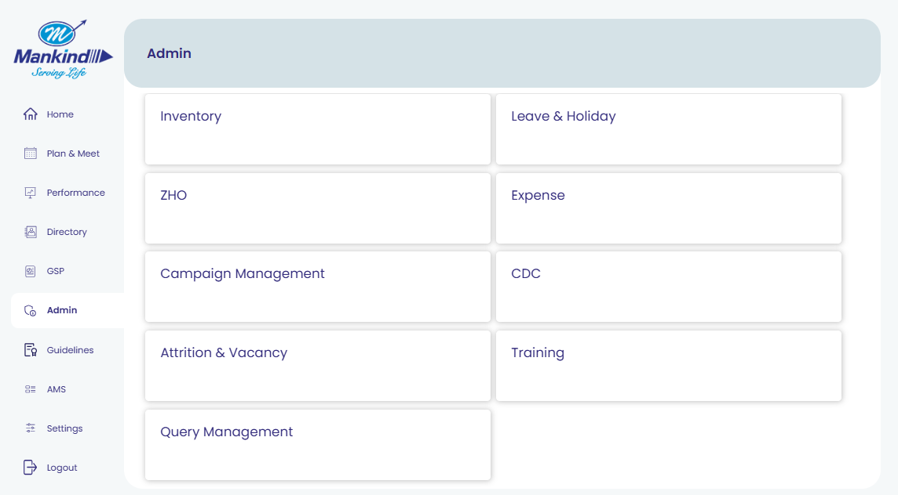
Admin option is for a variety of options related to the items and samples, leave, holiday etc.
For SLM
For FLM
Assessment is available for SLM and not for FLM

Slide 10
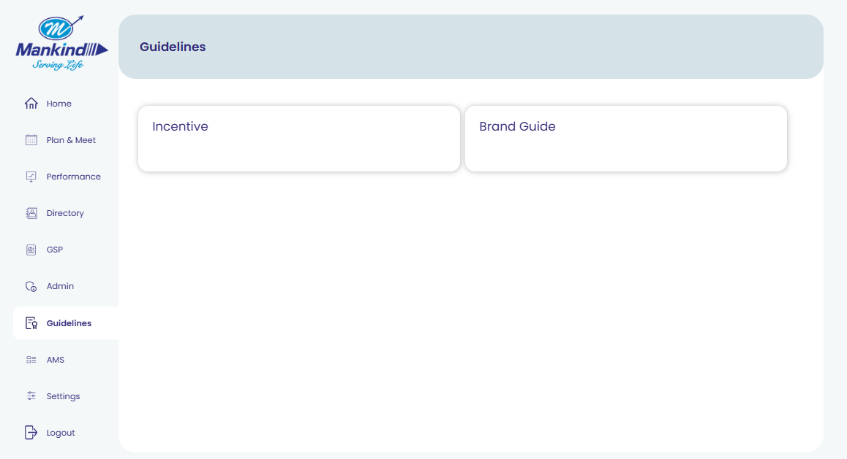
The Guidelines Module is for the Incentive policy and brand guide, updated by the admin

Slide 11
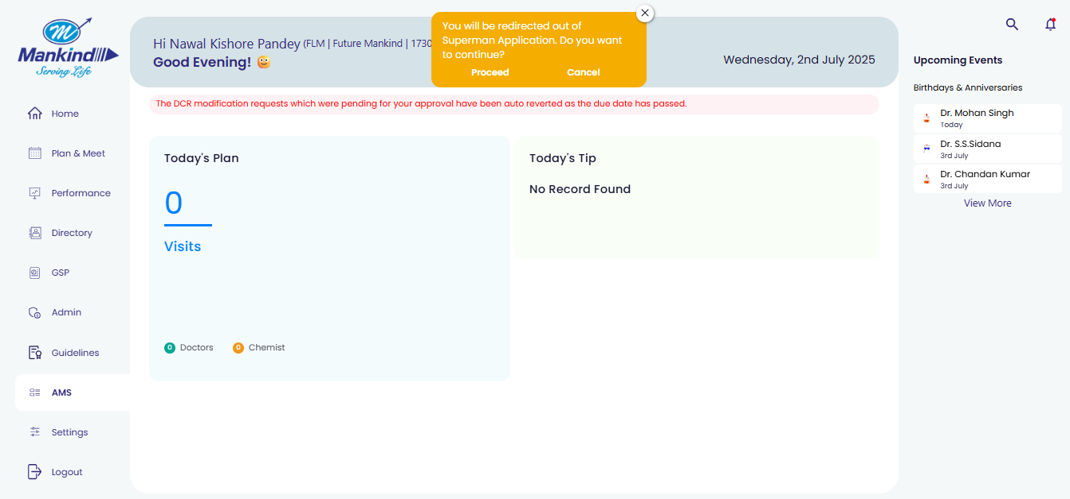
The AMS module redirects to the AMS production page if you click on proceed

Slide 12
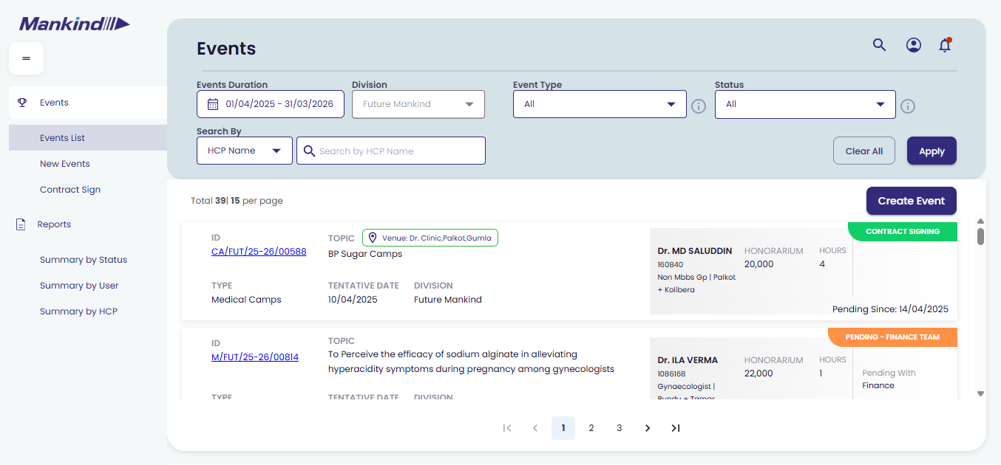
The AMS production landing page for the managers

Slide 13
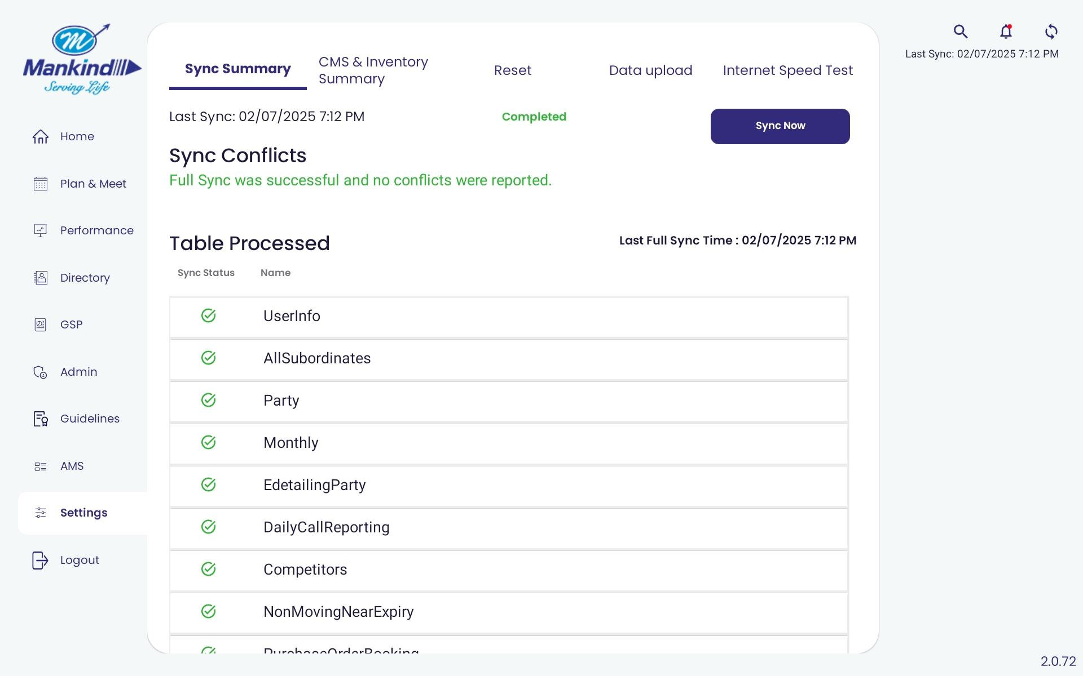
The settings option is provides the options to sync the data from the tab to the server and vice versa, for updating new brand slides and information.

Slide 14
Thank You!

